Slide 1
PHYSICS-2 PROJECT SUBMITTED TO SIR KHURRAM IQBAL
BY: SHEHARYAR (B16101146)
MUHAMMAD SALMAN(B16101110)
MUHAMMAD HAMZA(B16101093)
MUHAMMAD SUFYAN(
MUHMMAD WALEED KHAN(B16101122)
MAAZ KHAN(B16101104)
Muhammad Basher(B16101087)

Slide 2
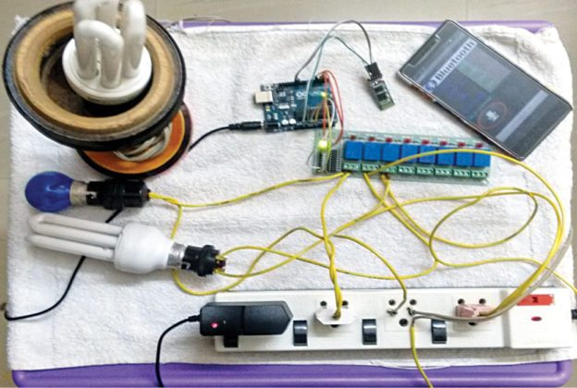
HOME AUTOMATION

Slide 3
WHAT DOES HOME AUTOMATION MEAN?

Slide 4
INTRODUCTION:
Nowadays, people have smartphones with them all the time. So it makes sense to use these to control home appliances.
Presented here is a home automation system using a simple Android app, which you can use to control electrical appliances.
Commands are sent via Bluetooth to Arduino Uno. So you need not get up to switch on or switch off the device while watching a movie or doing some work with clicks or voice commands.

Slide 5
Components used in HOME AUTOMATION:
Arduino Board
Transformer
Relays
Capacitors
Bluetooth device
Resistors
Potentiometer
Heat sink
Tsop(IR receiver)

Slide 6
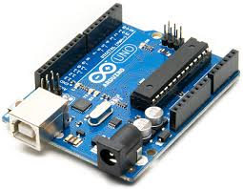
ARDUINO BOARD:

Slide 7
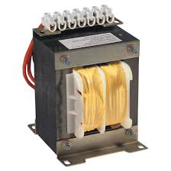
Transformer:

Slide 8
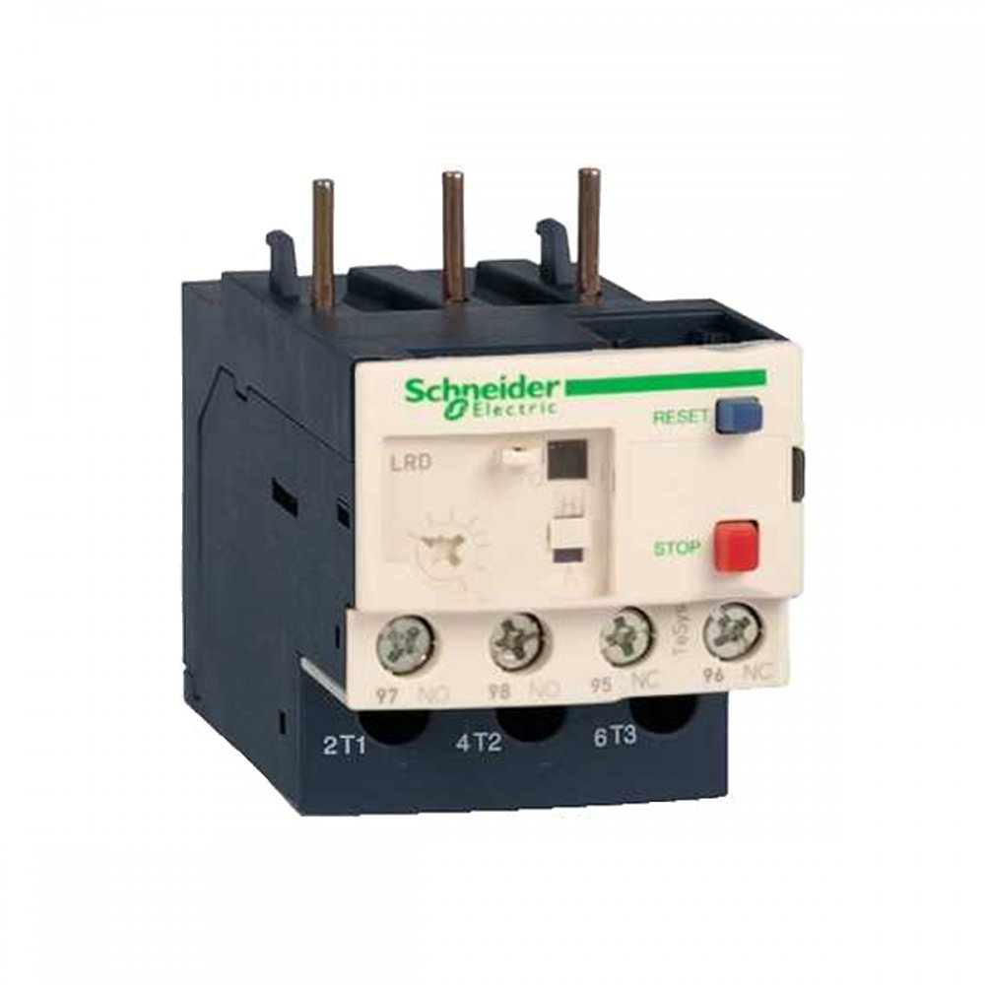
RELAYS:

Slide 9
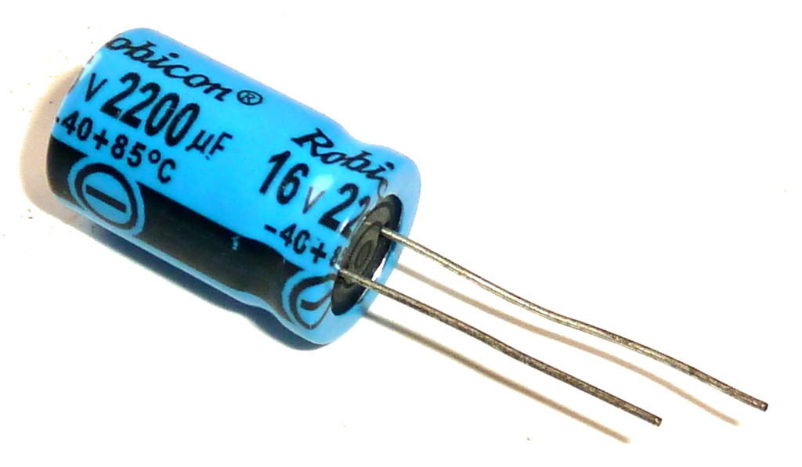
CAPACITORS:

Slide 10
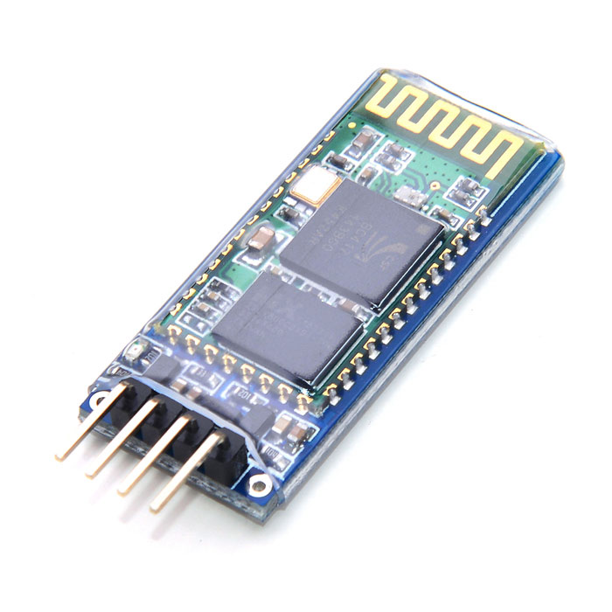
Bluetooth Device:

Slide 11
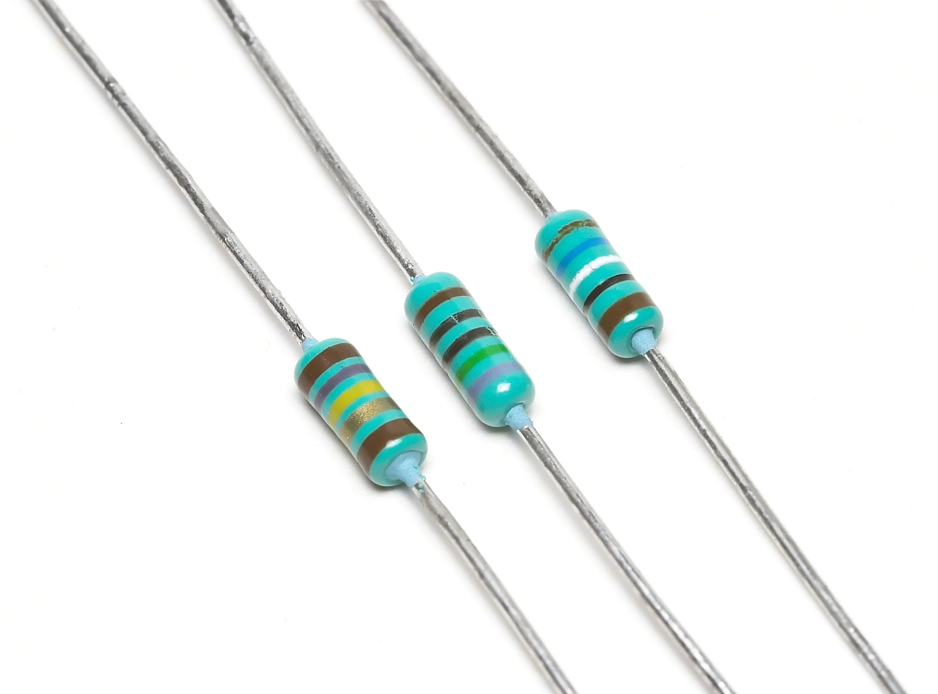
RESISTORS:

Slide 12
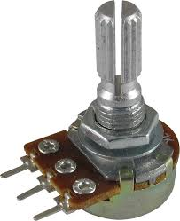
POTENTIOMETER(Resistor):

Slide 13
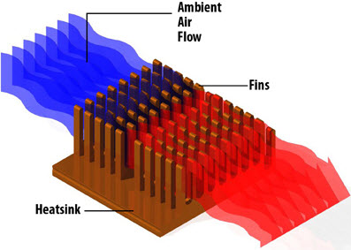
HEAT SINK:

Slide 14
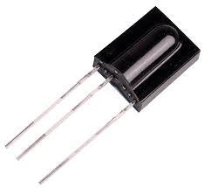
TSOP(IR RECEIVER):

Slide 15
CONSTRUCTION AND WORKING:
Transformer:
Starting from transformer it is used to convert our Ac voltage to Dc voltage and then current passes from the Capacitors.
Capacitors:
We have used capacitors to store energy and then provide a bunch of current to support arduino board.

Slide 16
CONSTRUCTION AND WORKING:
Heat sink:
Heat sink is used to control the heat produced in our arduino board.
Potentiometer:
Then we have used potentiometer it is used to resist the flow of current manually when we feel the voltage is not well then we use potentiometer in order to control the flow of unnecessary current to save our components from burning.

Slide 17
CONSTRUCTION AND WORKING:
Tsop:
Then move to tsop we have attached the tsop for giving signals to arduino board by remote devices i.e on/off.
Bluetooth device:
Bluetooth device serve same as tsop but it is used to control our electrical components like energy saver ,fan etc by catching the signals from our mobile phones and other devices like mobile phones.

Slide 18
CONSTRUCTION AND WORKING:
Relays:
Moving next to Relays. They are used to switch the electrical components like if we want to connect three things like bulb,fan and energy saver then if want to control the bulb at a time we control fan and at the same time our energy saver then it provides the connection to them through Pins. We have set 3 relays to switch the flow of current in which we set ON on 1,3 and 5 and Off on 2,4,6.Finally we have connected to wires which is connected to the transistors at the back of the board through solding that made the whole circuit to complete that’s it.

Slide 19
Software Components used to control this device:
1.Arduino IDE (using C Language ):
The Arduino Integrated Development Environment - or Arduino Software (IDE) - contains a text editor for writing code, a message area, a text console, a toolbar with buttons for common functions and a series of menus. It connects to the Arduino and Genuine hardware to upload programs and communicate with them.

Slide 20
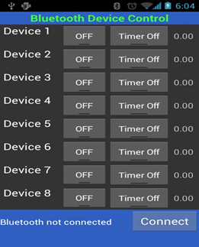
Software Components used to control this device:
2.ANDROID BLUETOOTH APPLICATION:
The application framework provides access to the Bluetooth functionality through the Android Bluetooth APIs. These APIs let applications wirelessly connect to other Bluetooth devices, enabling point-to-point and multipoint wireless features.

Slide 21
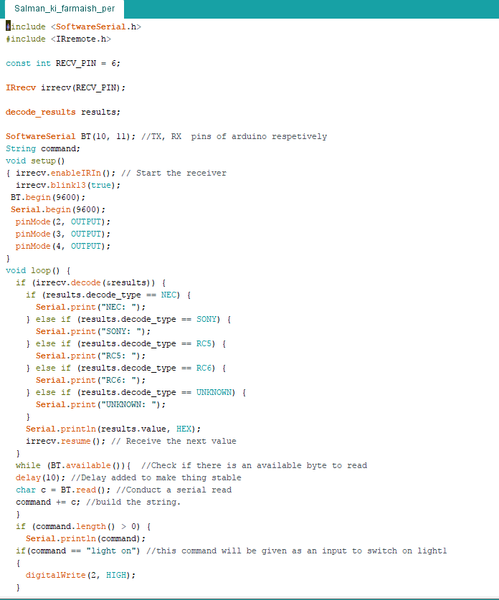
CODE OF OUR PROJECT:

Slide 22
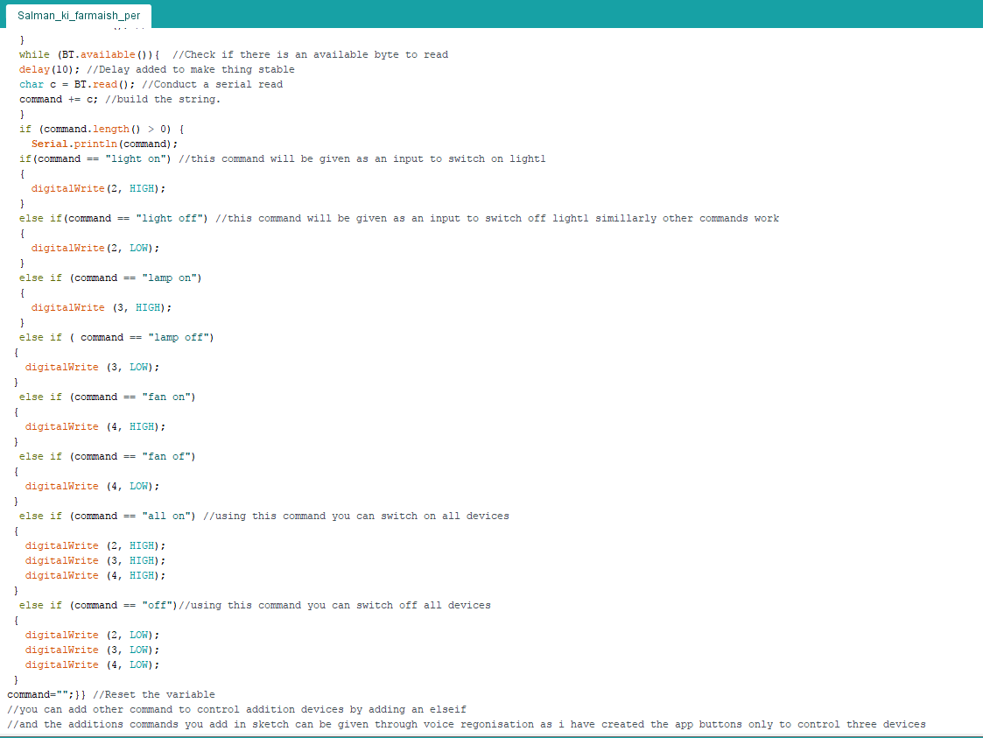
CODE OF OUR PROJECT:

Slide 23
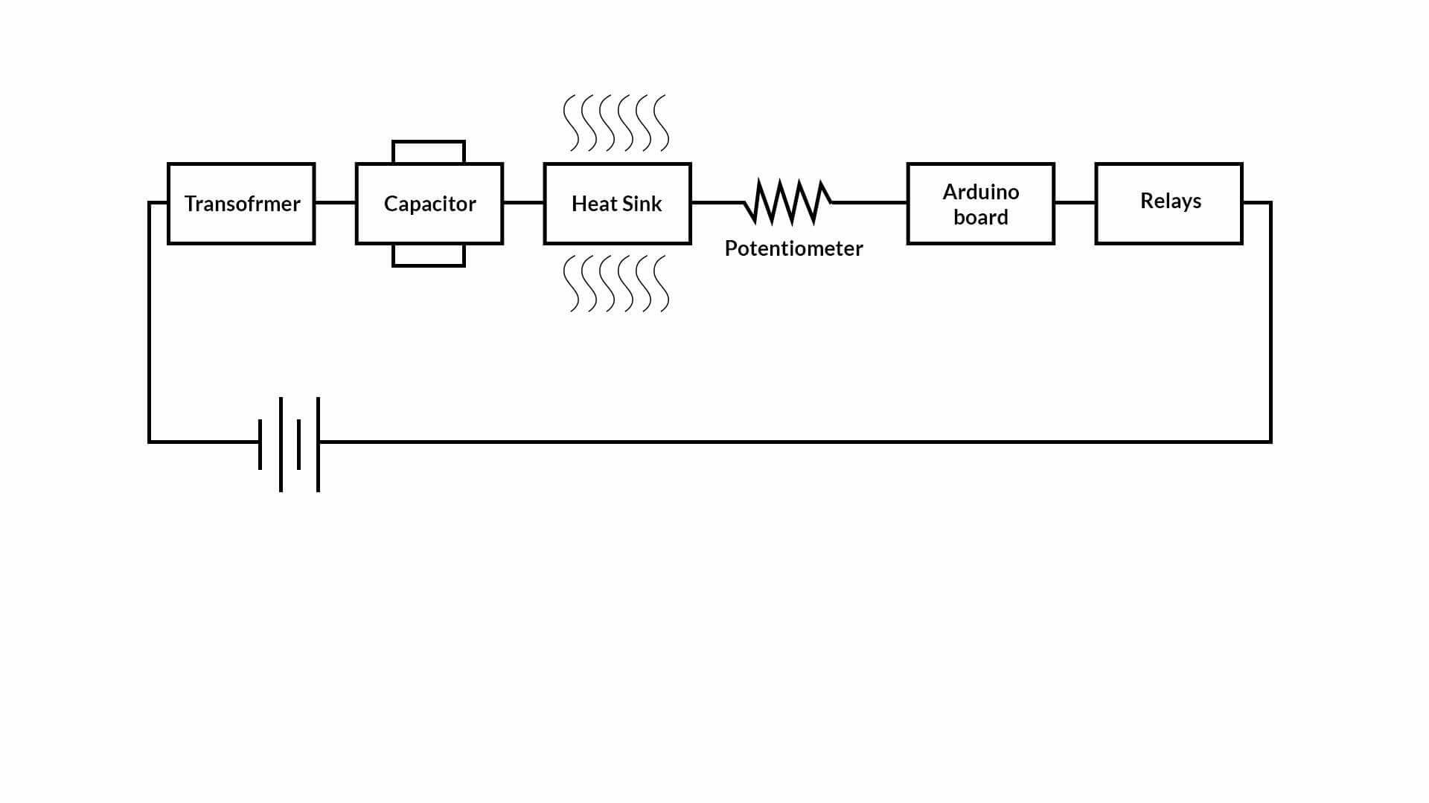
Circuit:

Slide 24
Conclusion and Results:
Conclusion:
The system as the name indicates, ‘Android based home automation’ makes the system more flexible and provides attractive user interface compared to other home automation systems. In this system we integrate mobile devices into home automation systems. A novel architecture for a home automation system is proposed using the relatively new communication technologies. The system consists of mainly three components is a Bluetooth module, Arduino microcontroller and relay circuits. Bluetooth is used as the communication channel between android phone and the Arduino microcontroller. We hide the complexity of the notions involved in the home automation system by including them into a simple, but comprehensive set of related concepts. This simplification is needed to fit as much of the functionality on the limited space offered by a mobile device’s display.

Slide 25
Conclusion and Results:
Results:
The current passes through the transformer which converts AC current to DC current .Current then passes through the capacitor, purpose to save the energy and powers the Arduino board .Heat sink is attached to the arduino board in order to protect the arduino board from heat up . The current passes through the transformer which converts AC current to DC current .Current then passes through the capacitor, purpose to save the energy and powers the Arduino board .Heat sink is attached to the arduino board in order to protect the arduino board from heat up .Bluetooth and Bluetooth and TSOP is connected to the arduino board which receives the data sent by the Bluetooth terminal App through Android Smart Phone or from the remote control .Relays are also connected to control the circuit .There are 3 relays present in the circuit in which we set up the pins 1 ,3 and 5 for the ON switch and pins 2 ,4 and 6 for the Off switch .A bulb is connected to the relays and turn on when receives the signals from the arduino board .

Slide 26
Thank You…...
Any Questions?????

